Slide 1
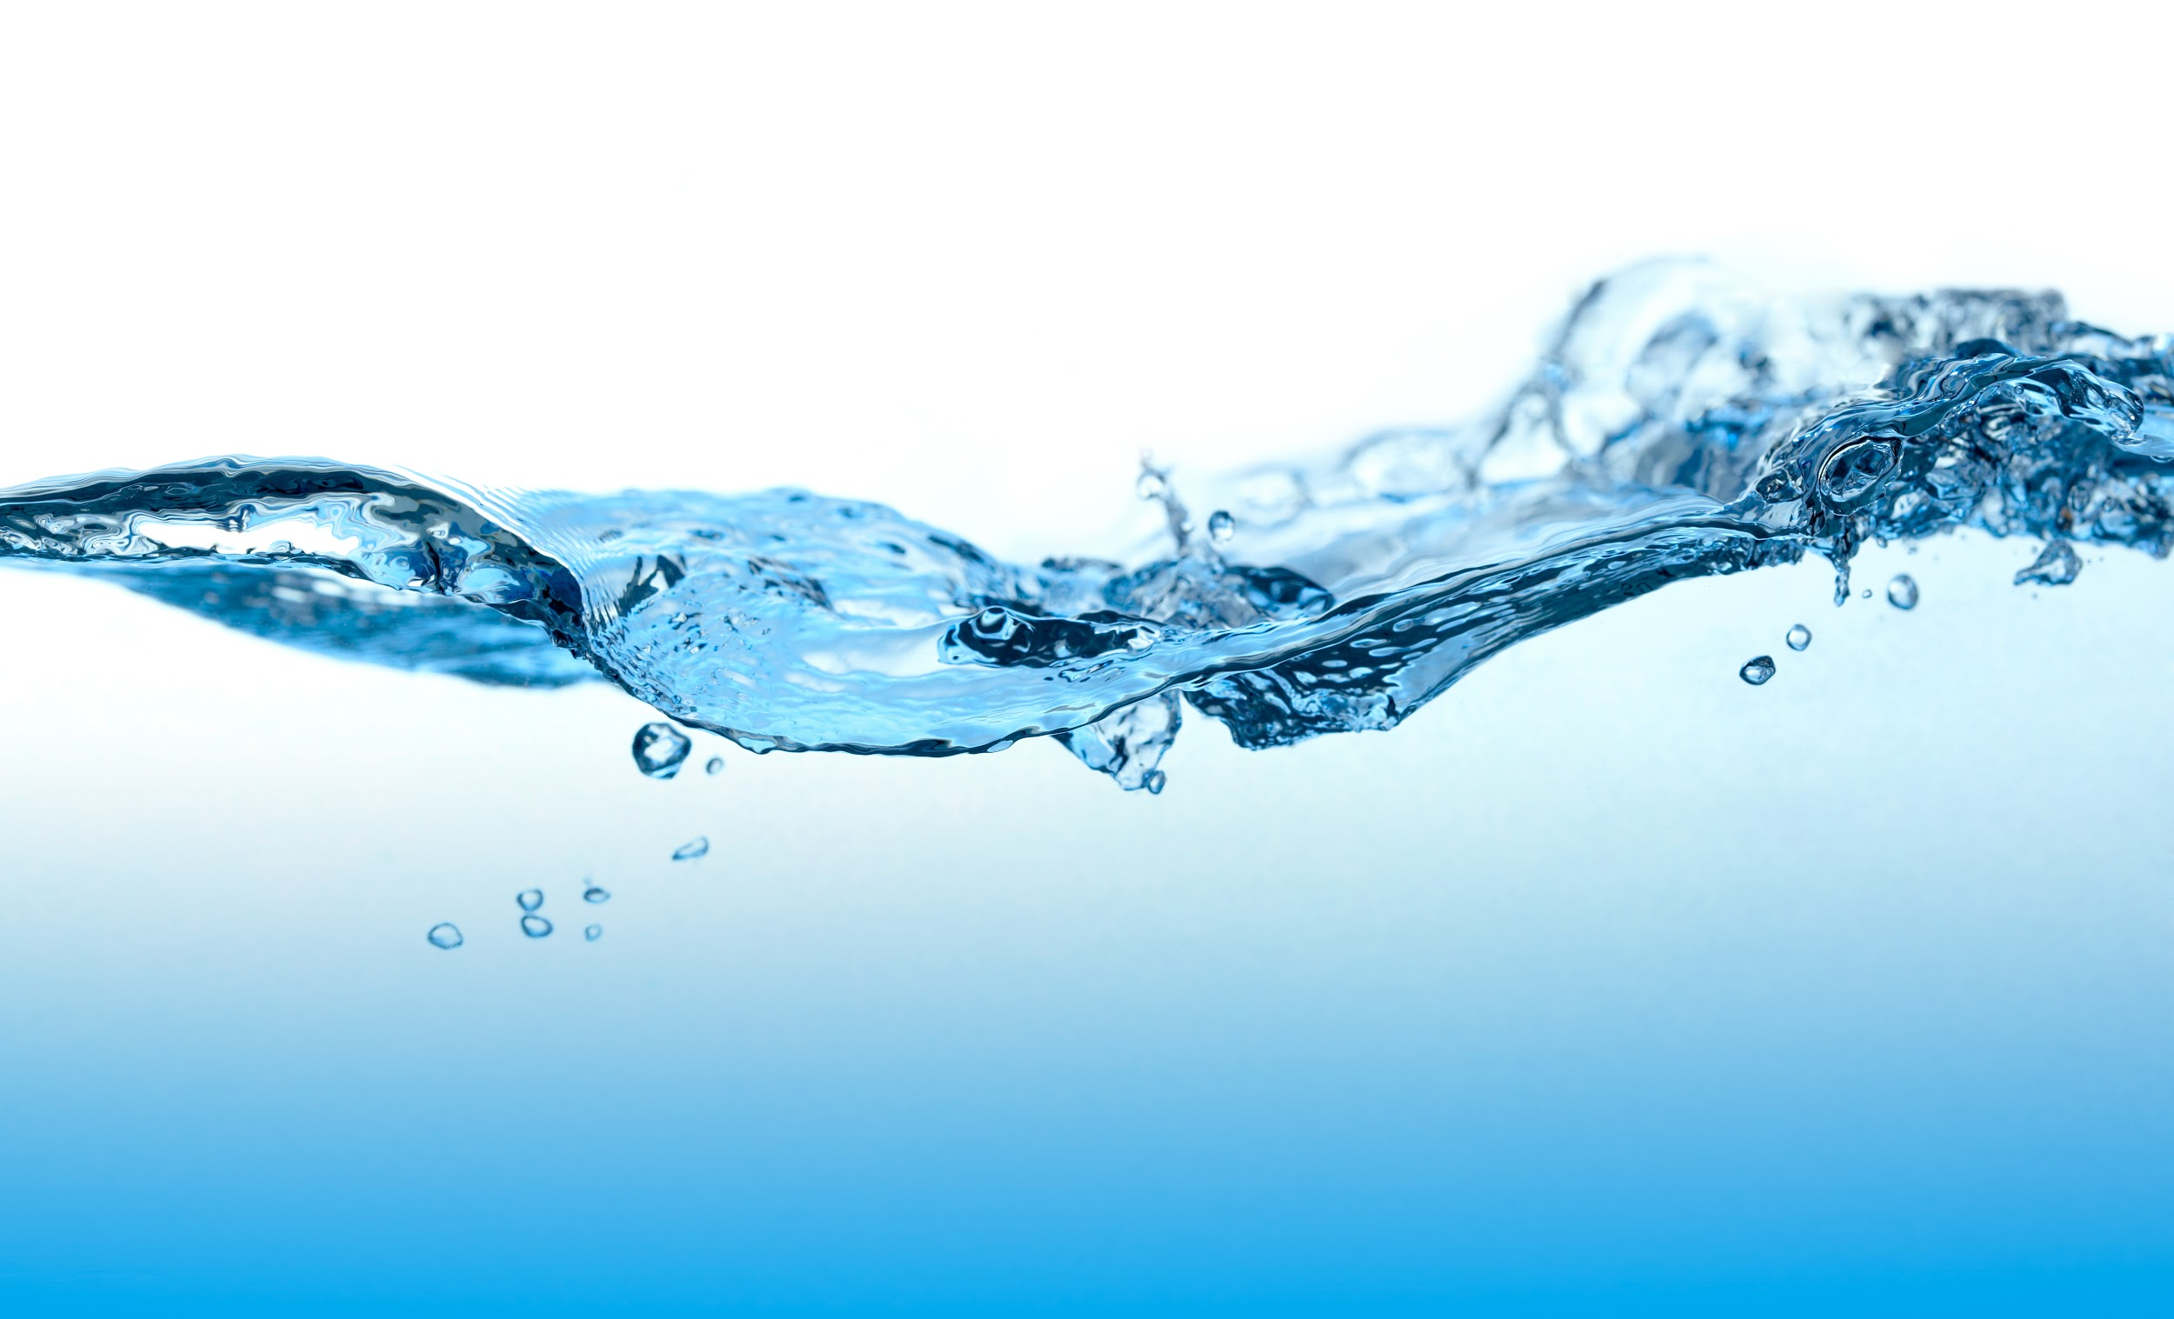
PVC Pipe Flocculator
Elle Blake, Kyle Glavey Weiss, and Joseph Pinnola-Vizza

Slide 2
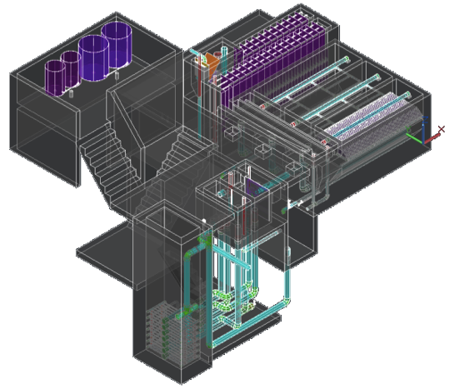
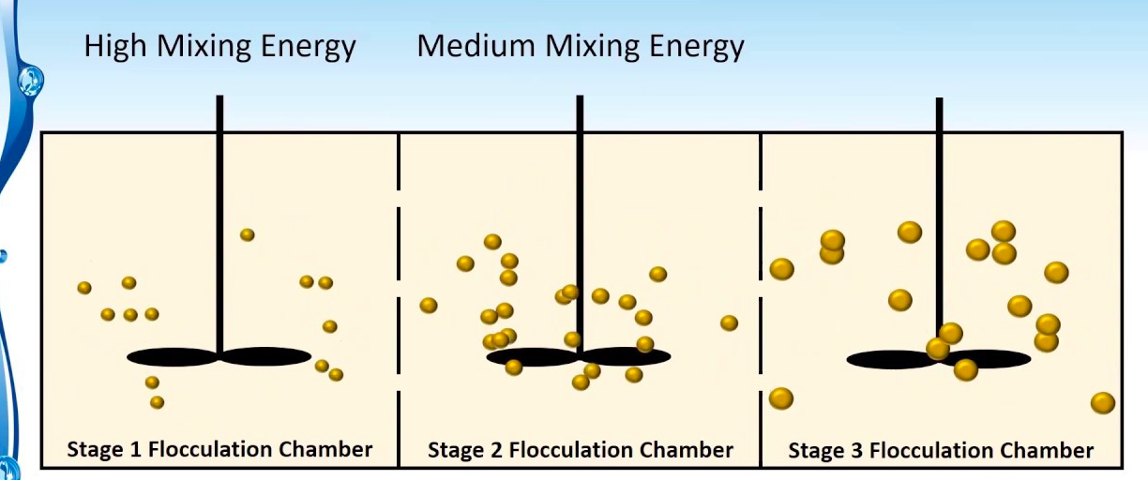
Identifying Need for Scalable Flocculators
Alternative option for communities with limited access to resources demanded by larger water treatment plants
Propose a solution towards bridging the gap of affordability and accessibility of the water treatment systems, specifically flocculation, designed using AguaClara’s source code
Notes:
https://i.ytimg.com/vi/eST7k0lSICw/maxresdefault.jpg

Slide 3

Project Goal
Design a design PVC pipe based flocculation systems to be incorporated in small scale (1-5 L/s) water treatment plants
Maximize the flexibility while minimizing the cost to allow the flocculator to be easily adaptable for various community requirements and limitations

Slide 4
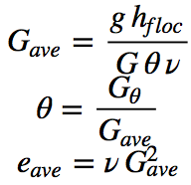
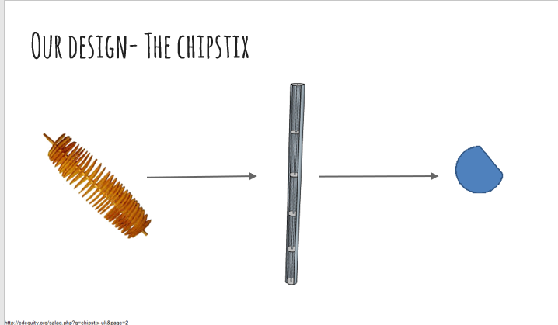
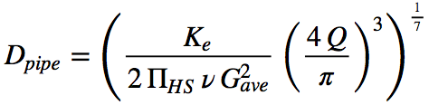
Design Derivation
Notes:
Our approach builds on traditional pipe flocculator models and the creative genius of a project from last year, who designed the chips on a stick system, where alternating “chips” are mounted on a central rod that can be easily inserted into a pvc pipe.
The professional software modeling on the last slide is an example of what this system could look like.
The key parameters for our system are total headloss and collision potential. And we use them here to calculate a diameter for our pipe.

Slide 5
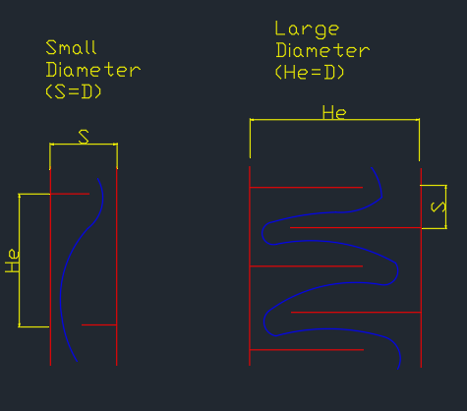
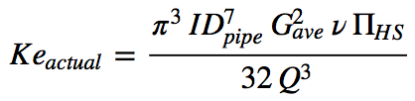
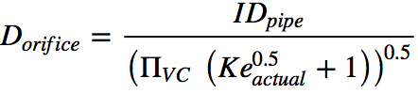
Design Derivation
Notes:
The diameter is then rounded to an available pipe size, and the actual Ke is calculated.
As you can see, the orifice equation relies n a vena contracta coefficient, which worried us because we are not confident of the value.
Instead, we used a different equation, that was based on the physical geometry of the orifice, rather than the arbitrary coefficient.
The image on the right illustrates the two extreme ways of modeling this system. We decided to go with the smaller diameter model because of the surprisingly steep price of larger pipes.

Slide 6
Pipe Flocculator Analysis and Key Constraints
Analysis
Input head loss as a constant, but then checked to ensure that our assumption met the output of our design
Initial Ke value relies on Vena Contracta for an orifice, which may not be representative of the true fluid mechanics
Constraints
Flow rate
Collision potential
Total head loss
He/S ratio
Coldest Water Temp
Pipe Sizes
Notes:
Once we had our design output, we calculated and confirmed the headloss through the system as a check on our methods.
Like I said l, a main issue was our reliance on a vena contracta coefficient that we did not know. Luckily, we were able to bypass his issue, with the professors help.
These are just some of the constraints that we needed to consider, as well as the size of the chip.

Slide 7
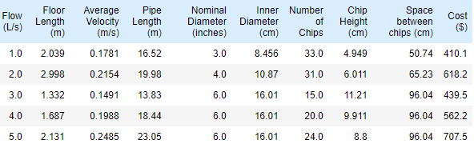
Design Outcome
Optimal solution of PVC pipe flocculator consists of the following based on the outputs of our design code:
3 L/s plant is the most cost/space effective due to pipe size availability

Slide 8
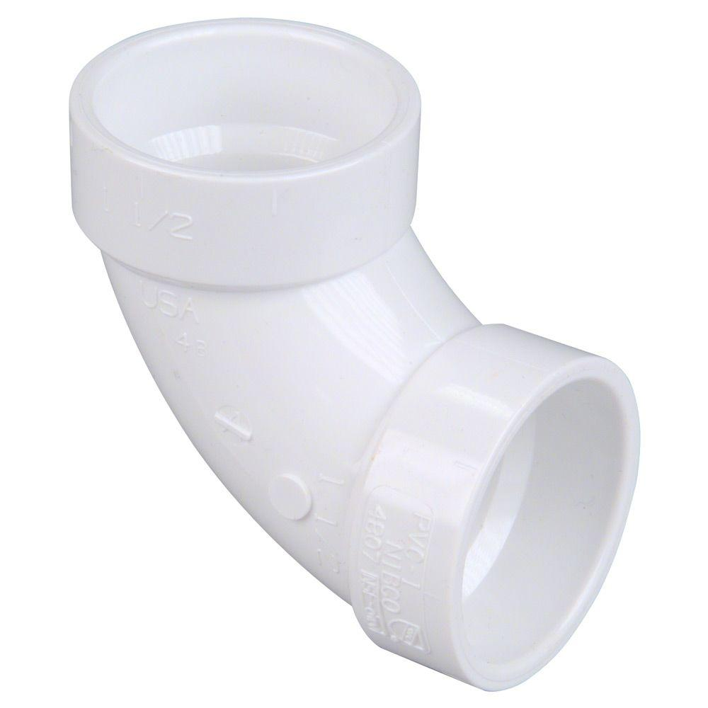
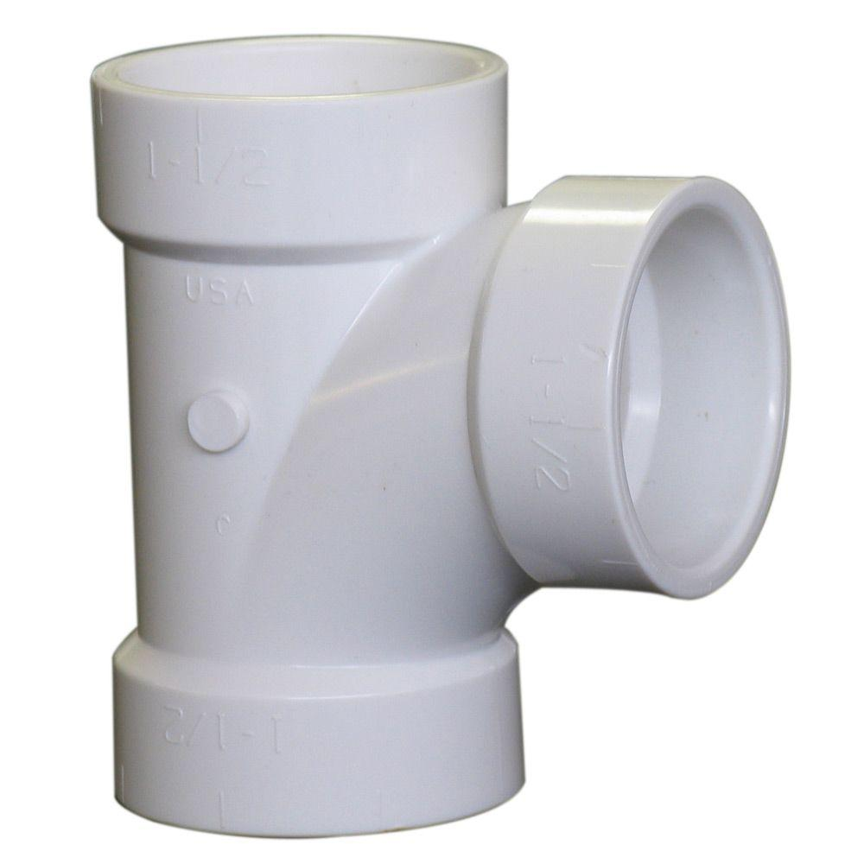
Cost Analysis
 | 3 inch | 4 inch | 6 inch
Piping | $1.714/foot | $2.151/foot | $3.961/foot
Tees | $3.94 each | $7.16 each | $32.37 each
Elbows | $3.53 each | $5.40 each | $23.30 each
Valves (estimate) | $10.00 each | $10.00 each | $10.00 each
Total Cost = (Pipe Length)(Pipe Cost) + (# Tees)(Tee Cost) +
(# Elbows)(Elbow Cost) + (# Elbows / 2)(Valve Cost)

Slide 9
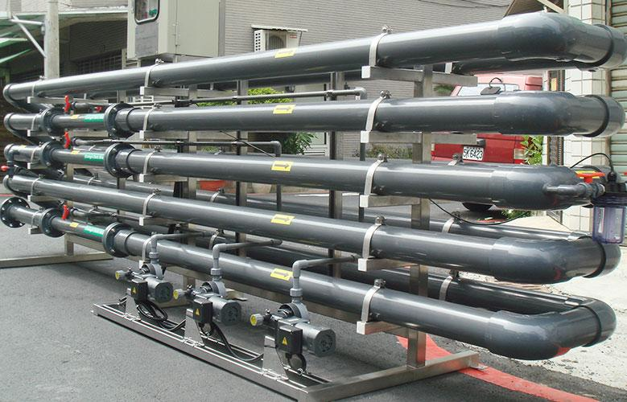
Pipe Flocculator Applications
Allow for AguaClara designs to be further scalable and adjustable to communities that are greatly limited by resources
A pipe flocculator of a 1-5 L/s size at costs from $400 to $700 depending on size and pipe inputs
Smaller flocculators result in shorter implementation period

Slide 10

Lessons Learned
The multidimensionality incorporated in the analysis of flocculators
Not one simple solution
Varying magnitude of influence for each input

Slide 11
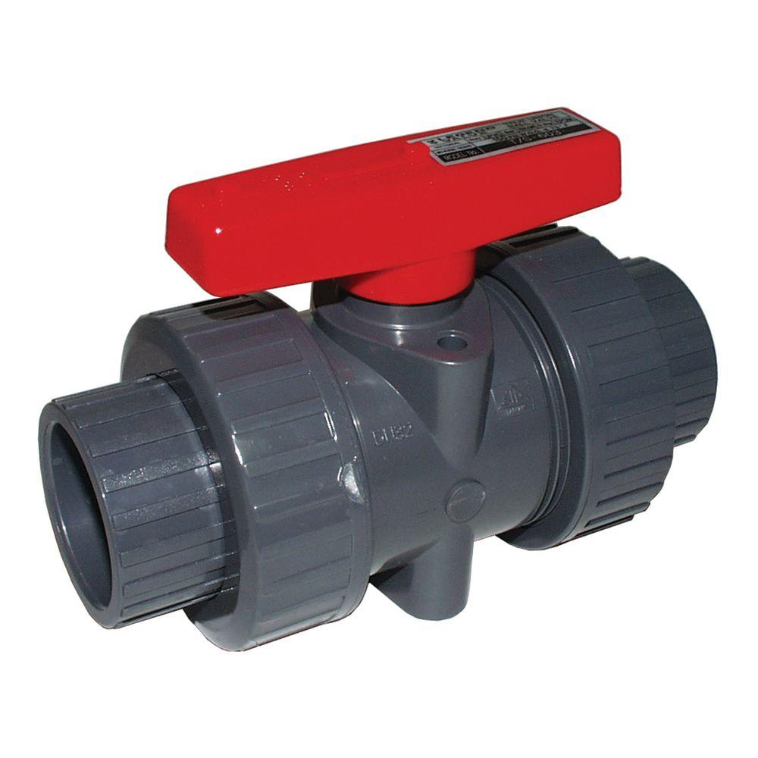
Further Development
Further cost analysis and breakdown of the availability of certain pipe components
Influence the number of bends and overall length of the flocculator design
Incorporate the minor head loss resulting from the 90 degree bends
Further research into Vena Contracta for chips
Optimal valve type and location

Slide 12
Questions?

